Slide 1
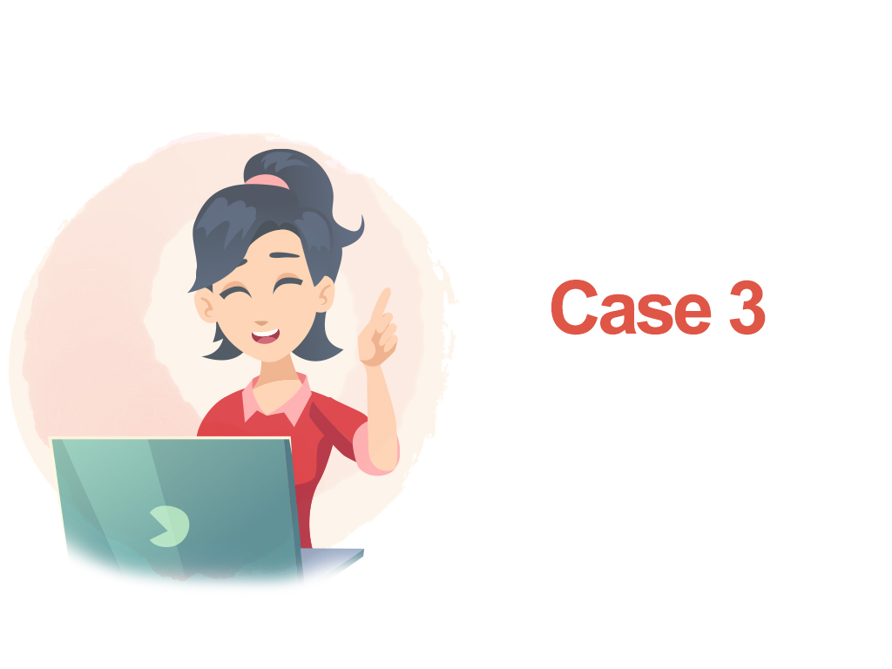

Slide 2


What is the definition of teaching materials?

Slide 3



Have you ever recommended websites to students?
Let’s talk about the websites you have recommended
and the reasons for selecting them.

Slide 4





Slide 5


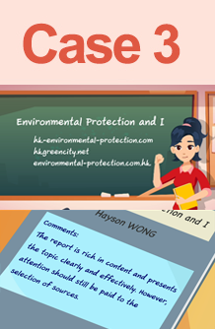
What are your thoughts on Miss Yuen’s
approach to recommending websites to
students? How should teachers help
students conduct proper online research?
Do you find Miss Yuen’s handling of
students’ reports desirable? Why?

Slide 6


Review school codes in connection
with the selection of teaching
materials/teaching content

Slide 7


Professional judgment
The content of teaching materials has a profound impact
on students. Teachers should demonstrate professionalism
and caution when selecting and compiling teaching materials.
Even in the case of recommended web links, teachers should
carefully assess whether the content is suitable for students
and ascertain its authenticity and reliability.

